Slide 1

UNIVERSAL INCUBATOR

Slide 2
Abstract
The aim of this project is to make an incubator that is capable to incubating eggs of different birds all in one machine.
The system consists of a main microcontroller board,different sensors such as humidity sensor,temperature sensor,heat source,humidity source,motors,LCD modules and control panel.
Values of temperature and humidity for different species are stored onboard and is as simple as selecting the correct one.

Slide 3
WORKING
Depending on type of Egg ,temperature and humidity goals are set.
Sensors Measure Temperature and Humidity.
Fan,Egg Actuator and Heating Element are controlled to keep atmosphere inside the incubation chamber as close to the target value as possible.
LCD display is used to visualize status of Incubation.

Slide 4
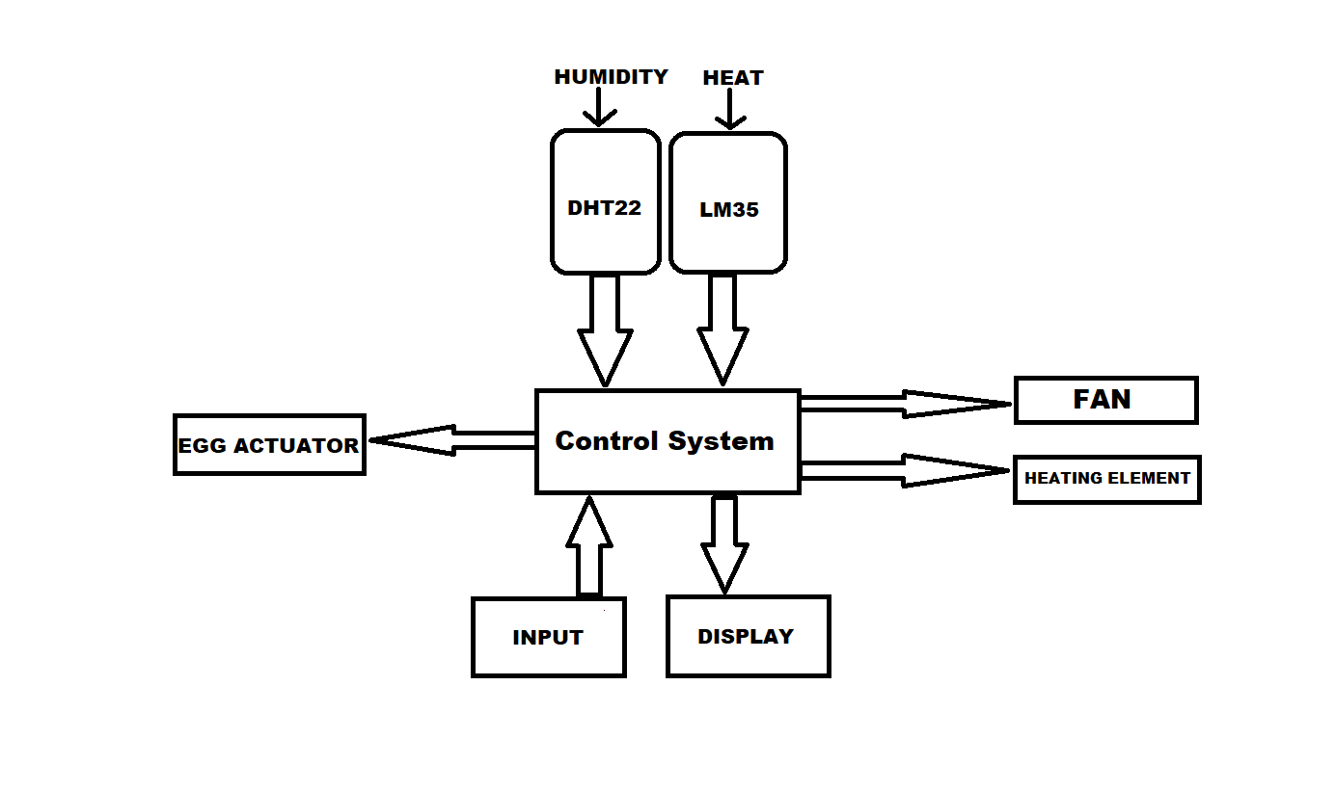
BLOCK DIAGRAM
BLOCK DIAGRAM

Slide 5
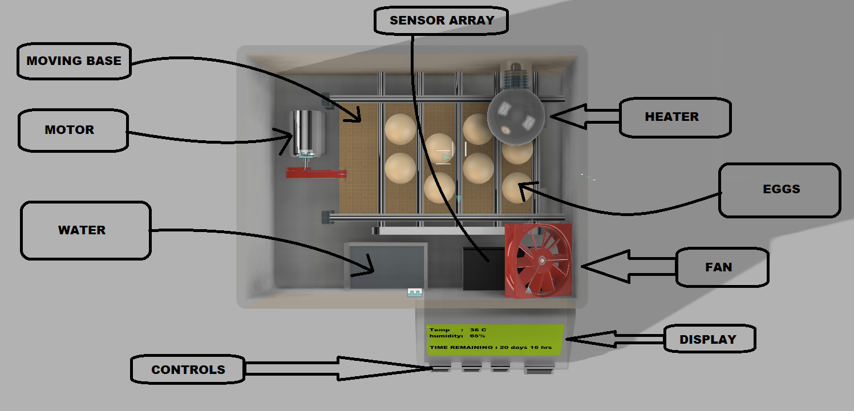

Slide 6
CIRCUIT

Slide 7
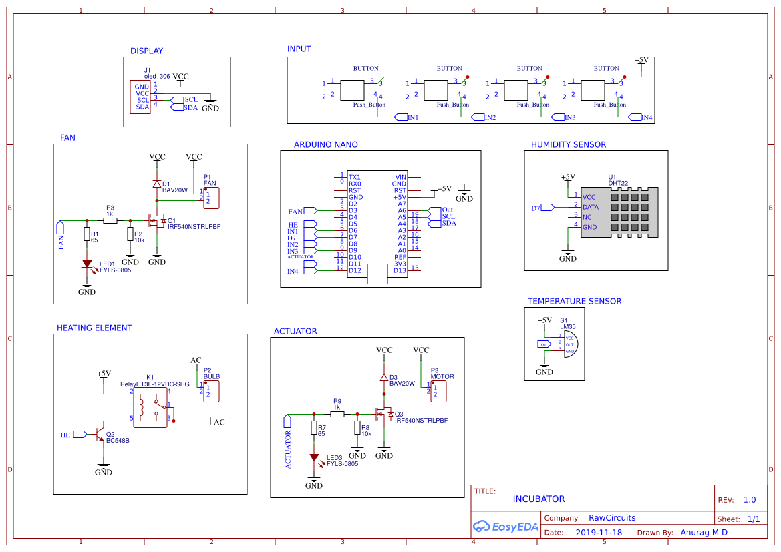

Slide 8
CAD

Slide 9
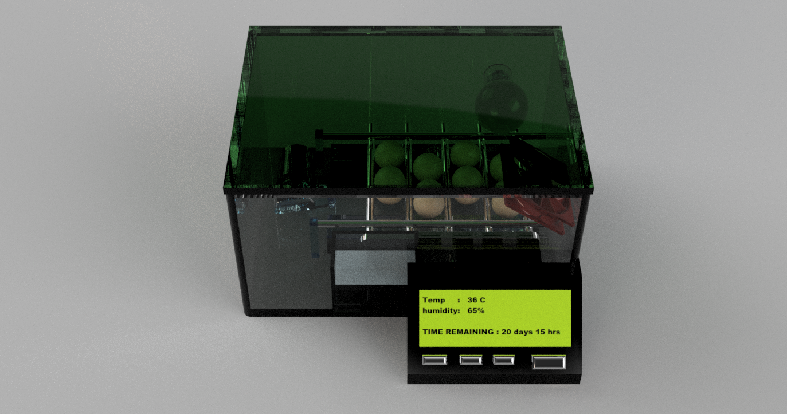

Slide 10


Slide 11
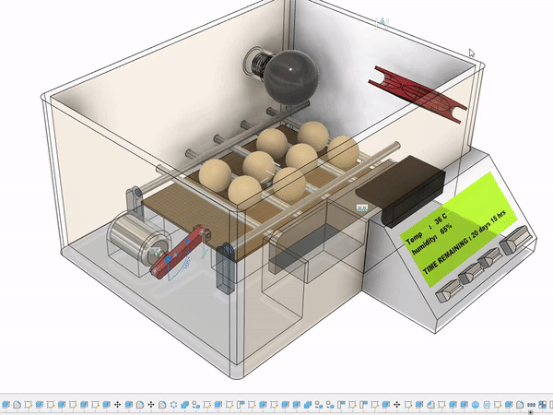

Slide 12
Advantages
Easy to use
Compact 210x300x220mm
Can be used for different eggs.
Reprogrammable.
Replacement parts easily available

Slide 13
Thank You

